Slide 1

Parsing lines; Dictionaries: operations with files; Looping
Python Programming | Loops, string, files, list, dictionaries and tuples
Course: Python Programming | Chapter: Loops, string, files, list, dictionaries and tuples | Program: Bachelor of Computer Science and Engineering
DISCOVER · LEARN · EMPOWER
Notes:
Welcome everyone to today's session on Python programming. We will focus on the critical skills of parsing lines, using dictionaries with files, and effective looping. These concepts form the backbone of data processing in real-world applications. Let us begin our journey into mastering these essential Python tools.

Slide 2
Course Outcomes
SLIDE 2 / 14
Course Outcome
CO | BT LEVEL | DESCRIPTION
CO1 | BT1 | Understand the syntax, control structures, and basic constructs of Python programming language
CO2 | BT3 | Apply functions, modules, and exception handling for modular program development
CO3 | BT3 | Implement data structures including lists, tuples, dictionaries, and sets for efficient data processing
CO4 | BT4 | Analyze and manipulate files, strings, and perform data handling operations
CO5 | BT5 | Design and develop real-world applications integrating multiple Python concepts
Chandigarh University
2 / 14
Notes:
Today's lecture directly addresses two specific course outcomes. First, we will analyze and manipulate files and strings to handle data effectively. Second, we will design applications that integrate loops and dictionaries to solve complex problems. These skills are essential for your engineering projects.

Slide 3
Learning Objectives
SLIDE 3 / 14
Learning Outcomes
1
Identify the purpose of parsing lines in text file processing
2
Explain how dictionaries store and retrieve data from files
3
Demonstrate looping techniques to iterate through file contents
4
Apply string methods to split and clean raw text data
5
Construct a program to count word frequencies using dictionaries
Chandigarh University
3 / 14
Notes:
By the end of this lecture, you will be able to identify why parsing lines is crucial for data extraction. You will explain how dictionaries act as efficient storage for file data. We will demonstrate looping techniques to process large datasets line by line. Finally, you will construct a program to count word frequencies, a classic real-world example.

Slide 4
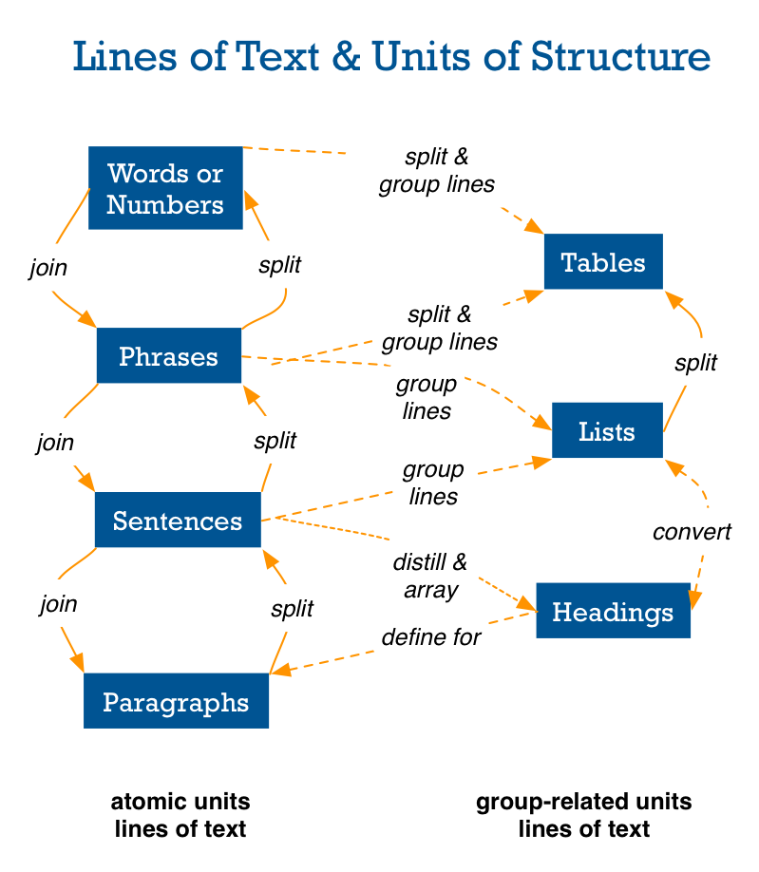
Lecture
SLIDE 4 / 14
Understanding Line Parsing Concepts
1
Parsing lines involves breaking raw text into meaningful individual components
2
The split() method separates a string into a list of substrings
3
Whitespace characters like spaces and newlines act as default delimiters
4
Custom delimiters allow splitting text by specific characters like commas
5
Parsing converts unstructured text into structured data for further processing
The Lazy Person's Guide to Text Wrangling - Story Needle
Chandigarh University
4 / 14
Notes:
Parsing lines is the process of breaking raw text into meaningful components. The split() method is your primary tool, separating strings by whitespace or custom delimiters. For example, splitting 'apple,banana,cherry' by a comma gives you a list of three items. This conversion from unstructured text to structured data is the first step in data handling.

Slide 5
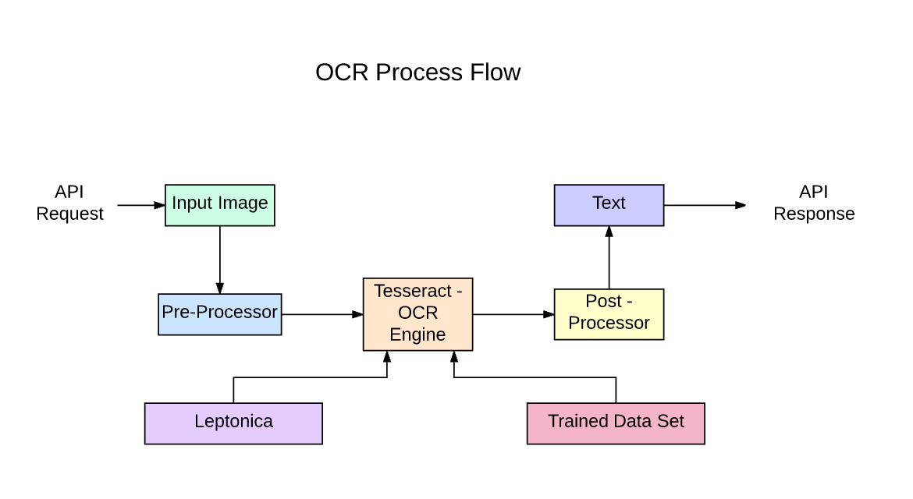
Lecture
SLIDE 5 / 14
Iterating Files with Loops
1
The for loop iterates directly over file objects line by line
2
This method is memory efficient for processing large text files
3
Each iteration variable holds the current line as a string object
4
The strip() method removes trailing newline characters from each line
5
Looping allows processing every line without loading the entire file
How to Parse Files in 2024 using OCR, Python, Java, Ruby (source: storage.ghost.io)
Chandigarh University
5 / 14
Notes:
The most efficient way to read files is using a for loop directly on the file object. This approach is memory efficient because it processes one line at a time. Each iteration variable holds the current line as a string, which you can immediately process. Always use strip() to remove the trailing newline character before further processing.

Slide 6
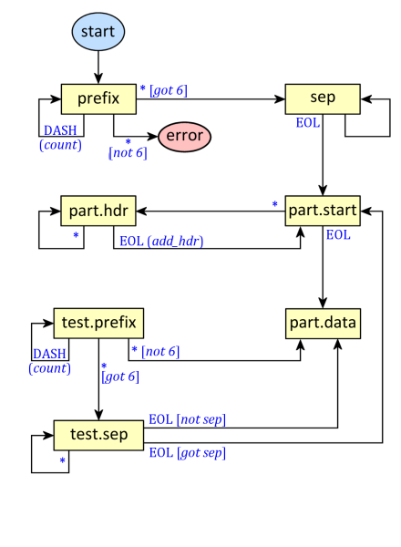
Lecture
SLIDE 6 / 14
Dictionaries for Data Aggregation
1
Dictionaries map unique keys to associated values for fast lookups
2
They are ideal for counting occurrences of items in a dataset
3
The get() method retrieves values safely without raising errors
4
Default values can be initialized to zero for counting operations
5
Dictionaries allow aggregating data while iterating through file lines
Parsing Multipart Form Data | The Hard-Core Coder (source: thehardcorecoder.com)
Chandigarh University
6 / 14
Notes:
Dictionaries map unique keys to values, making them perfect for counting occurrences. They allow fast lookups and are ideal for aggregating data while you iterate. The get() method is crucial here, as it retrieves values safely without raising errors for missing keys. You can initialize counts to zero to track frequencies efficiently.

Slide 7
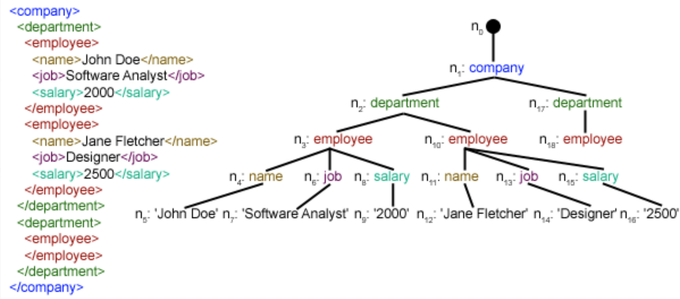
Worked Example
SLIDE 7 / 14
Word Frequency
INPUT FILE CONTAINS
'apple banana apple cherry banana apple'
FINAL RESULT
{'apple': 3, 'banana': 2, 'cherry': 1}
• Initialize an empty dictionary to store word counts
• Loop through each line and split into individual words
• Update the dictionary count for each word found in the text
How to Parse Files in 2024 using OCR, Python, Java, Ruby (source: storage.ghost.io)
Chandigarh University
7 / 14
Notes:
Let's walk through a concrete example. If our input file contains 'apple banana apple cherry banana apple', we start with an empty dictionary. As we loop through, we split the text and update counts. After processing, the dictionary shows 'apple' appears 3 ×, 'banana' 2 ×, and 'cherry' once. This demonstrates how loops and dictionaries work together seamlessly.

Slide 8
Lecture
SLIDE 8 / 14
Handling File Operations Safely
1
Always use the 'with' statement to manage file resources automatically
2
The 'with' block ensures files are closed even if errors occur
3
Opening files in read mode ('r') is standard for parsing operations
4
FileNotFoundError must be handled to prevent program crashes
5
Proper file handling prevents data loss and resource leaks
How to Parse Files in 2024 using OCR, Python, Java, Ruby (source: storage.ghost.io)
Chandigarh University
8 / 14
Notes:
Safe file handling is critical in Python programming. Always use the 'with' statement to manage file resources automatically. This ensures files are closed even if errors occur during processing. Opening files in read mode is standard for parsing, but you must handle FileNotFoundError to prevent crashes. This practice prevents data loss and resource leaks.

Slide 9
Lecture
SLIDE 9 / 14
Common Pitfalls in Parsing
1
Forgetting to strip newline characters causes mismatched string comparisons
2
Using incorrect delimiters leads to empty strings or wrong splits
3
Modifying a dictionary while iterating over it causes runtime errors
4
Not handling encoding issues can result in UnicodeDecodeError exceptions
5
Assuming all lines have the same format leads to index errors
Parsing Multipart Form Data | The Hard-Core Coder (source: thehardcorecoder.com)
Chandigarh University
9 / 14
Notes:
There are several common pitfalls you must avoid. Forgetting to strip newline characters causes mismatched string comparisons, leading to incorrect counts. Using incorrect delimiters can result in empty strings or wrong splits. Additionally, modifying a dictionary while iterating over it causes runtime errors. Always handle encoding issues to prevent UnicodeDecodeError exceptions.

Slide 10
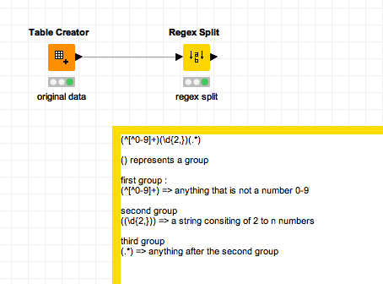
Lecture
SLIDE 10 / 14
Advanced Splitting Techniques
1
Splitting by multiple delimiters requires nested loops or regex
2
The split() method with maxsplit limits the number of splits
3
Regular expressions offer powerful patterns for complex text parsing
4
Handling quoted strings requires careful logic to avoid errors
5
Custom parsing logic handles irregular data formats effectively
Source: forum-cdn.knime.com
Chandigarh University
10 / 14
Notes:
Advanced splitting techniques allow you to handle complex text formats. The split() method with maxsplit limits the number of splits, useful for fixed-width data. Regular expressions offer powerful patterns for complex text parsing scenarios. Handling quoted strings requires careful logic to avoid errors, and custom parsing logic handles irregular data formats effectively.

Slide 11
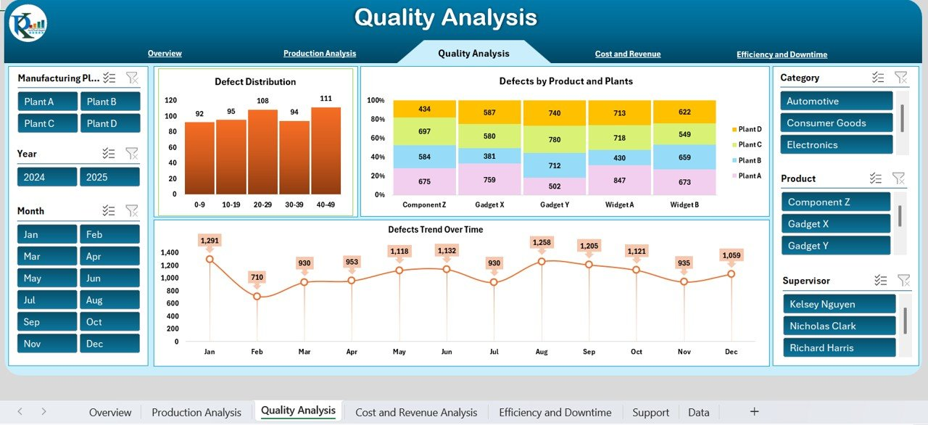
Lecture
SLIDE 11 / 14
Real-World Application: Log Analysis
1
Log files contain timestamped entries requiring line-by-line parsing
2
Dictionaries aggregate error counts by type for reporting
3
Looping extracts specific patterns like 'ERROR' or 'WARNING' tags
4
Parsing converts raw logs into structured statistics for analysis
5
This approach helps identify system issues quickly and efficiently
Source: nextgentemplates.com
Chandigarh University
11 / 14
Notes:
Consider a real-world application like log analysis. Log files contain timestamped entries requiring line-by-line parsing. Dictionaries aggregate error counts by type for reporting, while looping extracts specific patterns like 'ERROR' or 'WARNING' tags. Parsing converts raw logs into structured statistics, helping you identify system issues quickly and efficiently.

Slide 12
Lecture
SLIDE 12 / 14
Optimizing Loop Performance
1
Avoid nested loops when a single pass can solve the problem
2
Use dictionary lookups instead of repeated list searches for speed
3
Pre-allocate data structures when the size is known beforehand
4
Minimize string concatenation inside loops to improve performance
5
Efficient looping reduces execution time for large datasets significantly
Chandigarh University
12 / 14
Notes:
Optimizing loop performance is crucial for handling large datasets. Avoid nested loops when a single pass can solve the problem. Use dictionary lookups instead of repeated list searches for speed. Minimize string concatenation inside loops to improve performance, as efficient looping reduces execution time significantly.

Slide 13
Lecture
SLIDE 13 / 14
Key Takeaways
1
Parsing lines converts raw text into structured, processable data
2
Dictionaries provide efficient storage for aggregating and counting data
3
For loops iterate over files line-by-line for memory efficiency
4
Safe file handling with 'with' prevents resource leaks and errors
5
Combining these concepts enables powerful data analysis applications
Chandigarh University
13 / 14
Notes:
To summarize, parsing lines converts raw text into structured, processable data. Dictionaries provide efficient storage for aggregating and counting data. For loops iterate over files line-by-line for memory efficiency. Safe file handling with 'with' prevents resource leaks and errors. Combining these concepts enables powerful data analysis applications.

Slide 14
Lecture
SLIDE 14 / 14
References
PYTHON
A Practical Learning Approach, 1st Edition — T.S. Murugesh, Shriram K. Vasudevan, Sini Raj Pulari
• Learning Python, 6th Edition — Mark Lutz
• Starting Out with Python, Global Edition, 6th Edition — Tony Gaddis
• Introduction to Python Programming and Data Structures, 3rd Edition — Y. Daniel Liang
Chandigarh University
14 / 14
Notes:
For further reading, please refer to the recommended textbooks. 'Learning Python' by Mark Lutz offers deep insights into the language. 'Starting Out with Python' by Tony Gaddis provides excellent practical examples. 'Introduction to Python Programming' by Y. Daniel Liang and 'Python: A Practical Learning Approach' by Murugesh et al. are also essential resources for mastering these concepts.

